Slide 1
VROOM – Vehicle Rate Optimisation and Open Model
Car Price Prediction Model:
Rajani Muttumula
Samadhi Loku Hewage
Soheil Dabooyeh
Xingran Lu(Jane)

Slide 2
Key Points
Estimating car prices presents a significant challenge for both buyers and sellers. Traditional methods often depend on experience and subjective market trends, but machine learning offers a more precise, data-driven approach to prediction.
For this project, we utilised regression models to predict car prices based on various vehicle features. The dataset used was sourced from Kaggle, specifically the Australia Car Market Data. It contains over 17,000 records with 16 attributes such as price, brand, model, year, kilometers driven, fuel type, and more. The dataset spans vehicles from 1989 to 2023, with prices ranging from $1,000 to $999,000, including premium cars.
We performed data preprocessing by checking for duplicates and missing values, and removed irrelevant features.
To ensure compliance with copyright laws, we also verified that the dataset was free from any copyrighted content and that it did not contain any personal data. The dataset is publicly available and meets privacy and data protection standards. Additionally, we reviewed the dataset’s terms of use and licensing conditions before utilizing it.
Additionally, we developed a chatbot that leverages the trained model to predict car prices based on user inputs.

Slide 3
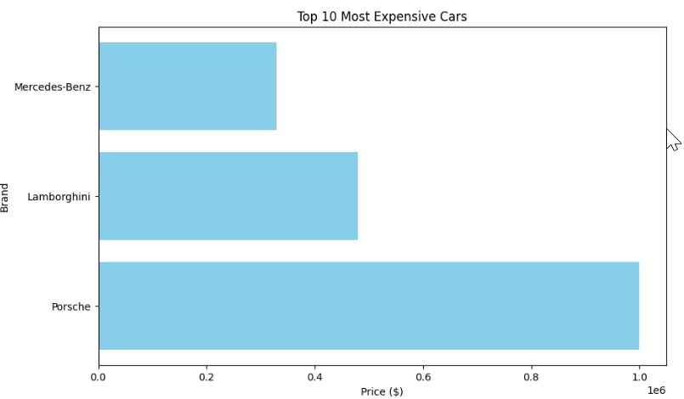
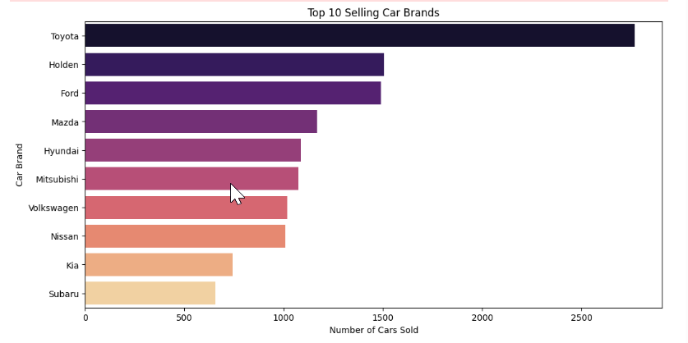
Top 10 expensive & selling cars brands

Slide 4
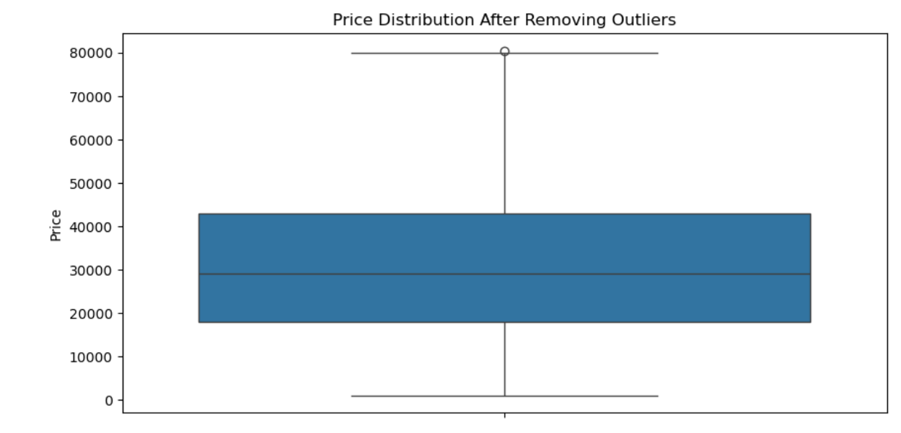
Objective: Predict car prices using machine learning
Steps Taken:
Data Cleaning: Handled missing values & duplicates.
Outlier Handling: Removed extreme values to improve model accuracy.
Feature Engineering: Created new features like Car_Age and Kilometers_per_Year to enhance model accuracy.
Modeling: Implemented a Random Forest Regressor and fine-tuned it for better performance.

Slide 5
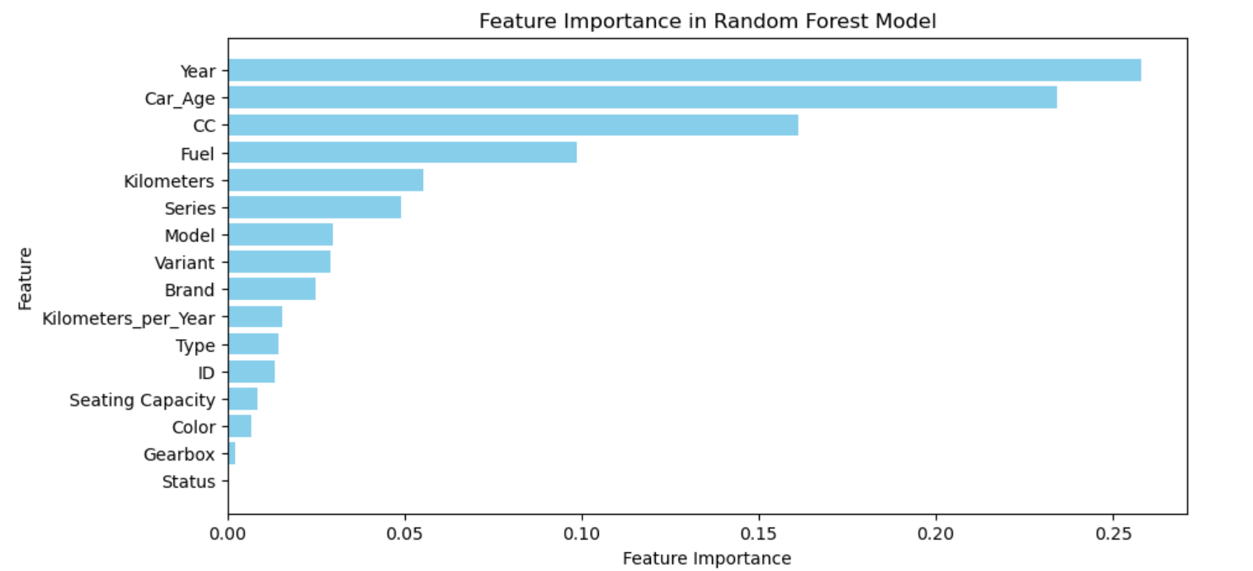
Key Insights from Data Analysis and Model Performance
Feature Importance:
The analysis identified the top predictors of car prices:
Manufacturing Year: Newer models generally command higher prices.
Car_Age: Older cars tend to have lower prices.
Engine Capacity (CC): Larger engines are associated with higher prices.
Fuel Type: Certain fuel types can significantly influence car value.
Kilometers Driven: Higher mileage often reduces a car's value.
Model Performance:
After tuning, the Random Forest Regressor achieved:
R² Score: 0.9146, indicating strong predictive capability.
Root Mean Squared Error (RMSE): 5068.54, reflecting the model's accuracy in predicting car prices.

Slide 6
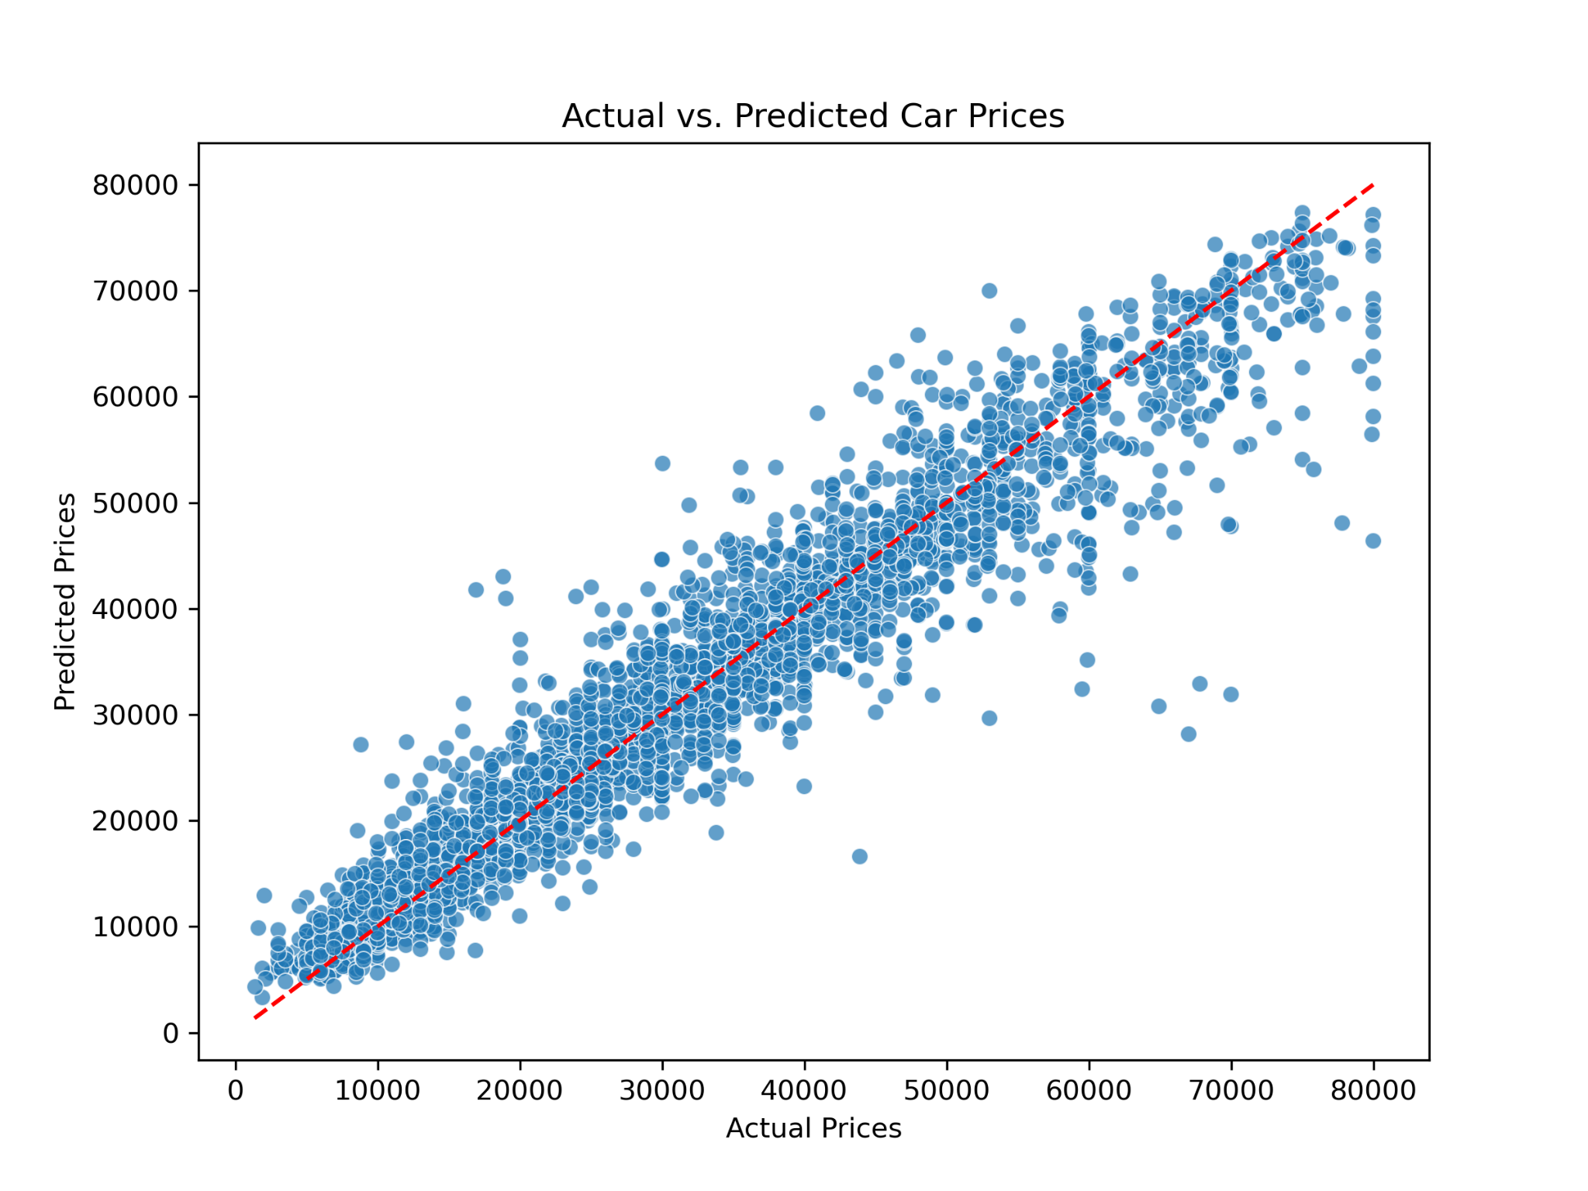
Actual vs. Predicted Car Prices
Scatter Plot: Display a scatter plot with actual car prices on the x-axis and predicted prices on the y-axis.

Slide 7
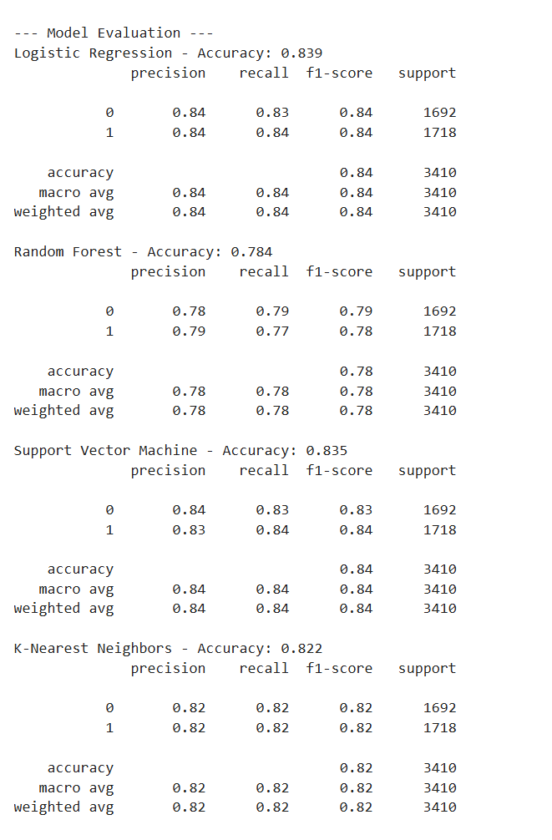
Machine Learning Model & Training
How we used machine learning to classify cars as Expensive or Affordable.
Step 1: Defining the Classification Problem
We categorised cars into Expensive (1) and Affordable (0) based on the median price in the dataset.
If a car’s price was above the median, it was labeled as Expensive, otherwise, it was Affordable.
Step 2: Preprocessing the Data
Encoded categorical features (Gearbox, Fuel Type, Car Type) into numerical values.
Standardised numerical features (Mileage) to improve model efficiency.
Split the dataset into 80% training and 20% testing to evaluate performance.

Slide 8
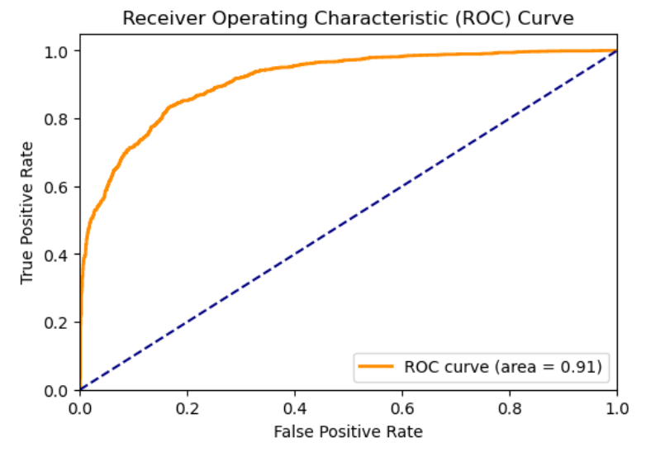
ROC Curve & AUC Score
This is the Receiver Operating Characteristic (ROC) Curve, which evaluates the performance of our classification model. The Area Under the Curve (AUC) score is 0.91, indicating a highly effective model.
The ROC curve plots the True Positive Rate (Sensitivity) vs. the False Positive Rate.
The further the orange line is away from the diagonal (random chance line), the better the model.
It provides a quantitative measure of how well the model classifies cars.
A high AUC score (0.91) confirms that the Logistic Regression model was the best choice.

Slide 9
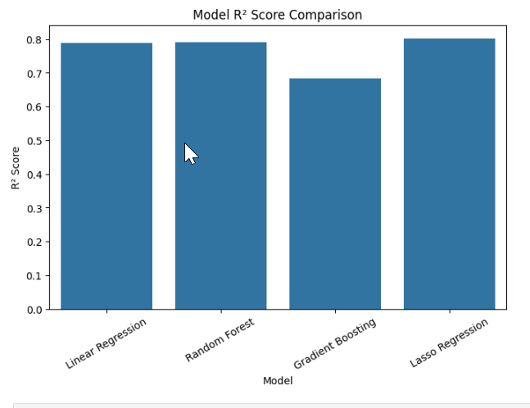
Model Initialisation: We initialise a set of models like LinearRegression, RandomForestRegressor, GradientBoostingRegressor, and Lasso.
Model Evaluation: After training each model, we evaluate them using R² (explained variance) (Indicates the proportion of the variance in the dependent variable that is predictable from the independent variables.Ranges from 0 to 1, where a higher value signifies a better fit of the model to the data.)and MAE (mean absolute error).(Measures the average magnitude of the errors in a set of predictions,)Lower MAE values indicate better model performance.

Slide 10
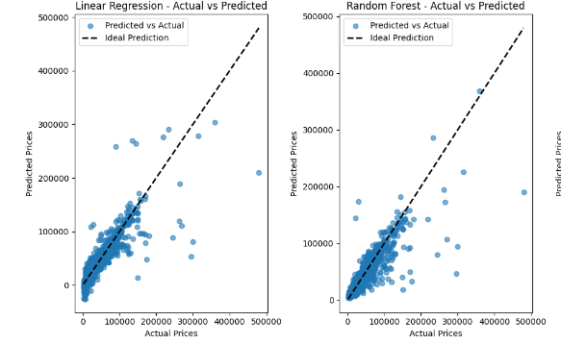

Slide 11
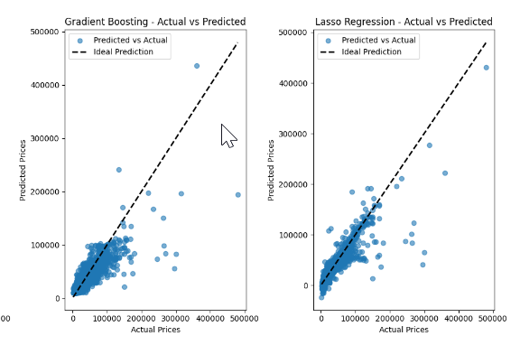

Slide 12
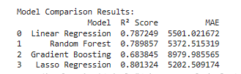
The table shows the performance of all of our machine learning models on our dataset, using R² Score and MAE (Mean Absolute Error) as metrics.
R² Score tells how well the model explains the variance in the data. The closer to 1, the better the model. Here, Lasso Regression has the highest R² at 0.801, meaning it explains 80.13% of the variance, which is the best.
MAE measures the average difference between the predicted and actual values. A lower MAE means better accuracy. Lasso Regression also has the lowest MAE (5202.51), meaning its predictions are closest to the actual values.
Summary:
Lasso Regression is the best model overall, with the highest R² and the lowest MAE.
Random Forest and Linear Regression perform similarly, but Gradient Boosting performs the worst in both R² and MAE.

Slide 13
Meet Your Intelligent Car Assistant
Powered by Machine Learning & NLP
Helps users navigate car shopping
Access to a database of 17,000+ vehicles
Provides personalised recommendations, price insights, and vehicle details
🔍Smart Search System
💰Comprehensive Pricing Insights
⚙️Advanced Search Filters

Slide 14
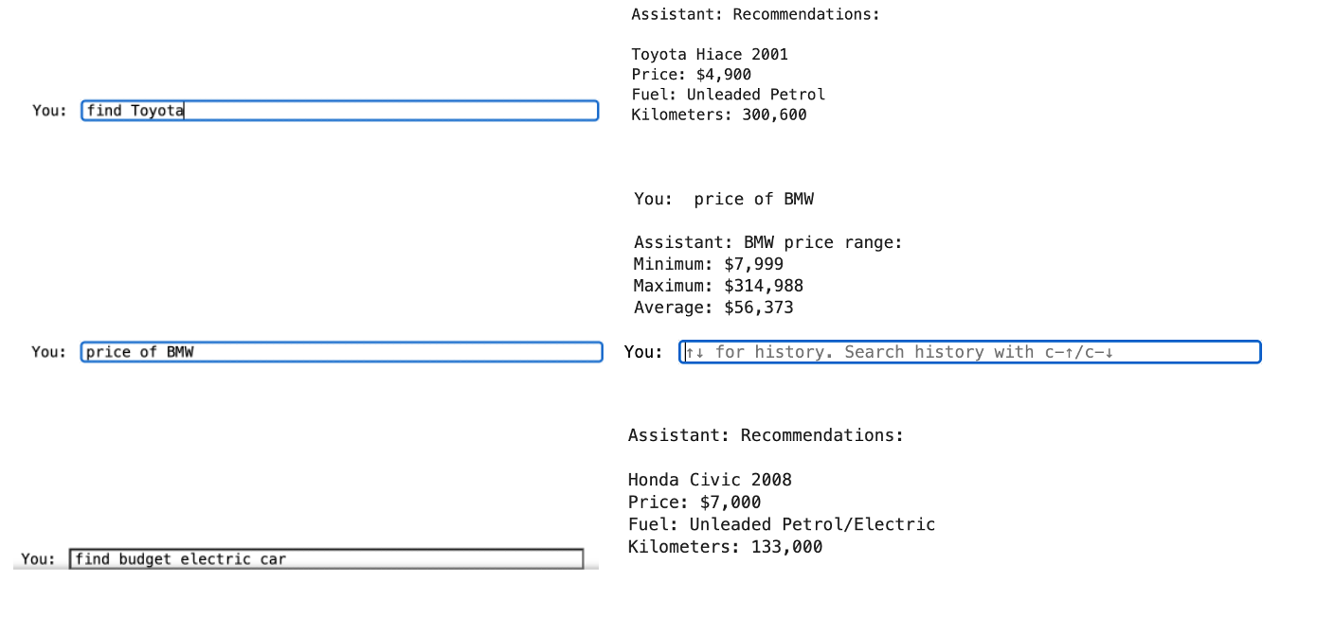

Slide 15
📂 SQL
Processes 17,000+ vehicle records
Performs age analysis, price-per-km calculations, and brand statistics
Lightning-fast queries (under 0.3s response time)

Slide 16
Thank You

